Slide 1

CSCI 4502/5502
Data Mining - Fall 2023 - Lecture 23
Ravi Starzl, PhD

Slide 2
Ethics in Data Mining
Ravi Starzl, PhD - Data Mining Fall 2023
Notes:
Ethics in data mining is an increasingly crucial consideration as our ability to extract meaningful information from large datasets grows. At the heart of these ethical concerns is the handling of privacy: ensuring personal data is collected, stored, and used with consent and appropriately anonymized to protect individual identities. Alongside privacy, the issues of data security are paramount, with a need for robust measures to prevent unauthorized access and breaches. Another significant ethical challenge is the potential for bias in data mining algorithms. These biases, often reflections of pre-existing societal biases, can lead to unfair or discriminatory outcomes. Transparency is also a key ethical aspect, both in terms of the algorithms used and the purposes for which data is mined. Users and subjects of data mining should be aware of how their information is used and for what reasons. Lastly, there is a growing need for accountability and governance in data mining practices. This includes adherence to various regulations, such as GDPR or HIPAA, and the development of industry-specific ethical guidelines and standards. As technology and its applications in data mining continue to evolve, so too must our approach to these ethical challenges, requiring ongoing dialogue and adaptation.

Slide 3
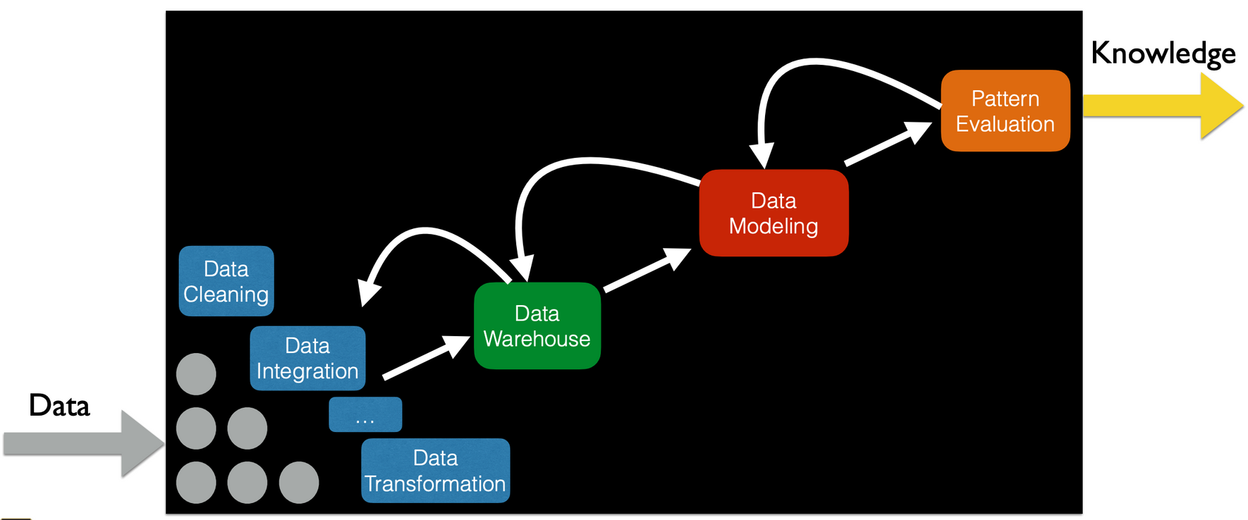
Data Mining Pipeline
Ravi Starzl, PhD - Data Mining Fall 2023

Slide 4

Examples
Tracking of user locations, social media posts, …
Anonymized medical records, search logs, reviews, …
Race, gender, religion, … name, zip code, movies, …
Decision support: admissions, grading, loan, insurance, hiring/promotion, advertisement, recommendation, …
Ravi Starzl, PhD - Data Mining Fall 2023
Notes:
In the data mining pipeline, various types of data such as user locations, social media posts, anonymized medical records, search logs, and reviews are collected and processed. This data often includes sensitive personal information like race, gender, religion, as well as general data like names, zip codes, and movie preferences. The collected data is then cleaned and preprocessed to ensure its quality and relevance for analysis.
The core of the pipeline involves applying sophisticated algorithms to uncover patterns and correlations, which are critical for decision support systems across various domains, including admissions, grading, loan approvals, insurance, hiring, promotions, targeted advertising, and personalized recommendations. The final stage focuses on interpreting these results, ensuring they are meaningful, valid, and free from biases. Throughout this process, ethical considerations, particularly regarding data privacy and security, are paramount to responsibly manage and utilize the vast and varied data.

Slide 5

Ethics Concerns
Data are about people and can do harm
Data ownership, informed consent
Data validity, privacy, anonymity
Data bias, model bias, adversarial attacks
Interpretation and application of data mining results
Ravi Starzl, PhD - Data Mining Fall 2023
Notes:
Data Ownership and Informed Consent: Questions of who owns the data and whether individuals have given informed consent for their data to be used are central. Ensuring that people understand how their data will be used and have agreed to this use is vital.
Data Validity, Privacy, and Anonymity: Ensuring the validity of data while maintaining the privacy and anonymity of the individuals it represents is a challenging balance. Privacy concerns are heightened with the potential for sensitive information to be exposed or misused.
Data and Model Bias: Data bias occurs when datasets do not accurately represent the population or phenomenon they are intended to reflect, often leading to skewed results. Model bias refers to prejudices inherent in the algorithms used for data mining, which can perpetuate and amplify existing societal biases.
Adversarial Attacks: These are deliberate attempts to manipulate or trick machine learning models, which can undermine the reliability and integrity of data mining processes and results.
Interpretation and Application of Data Mining Results: How the results of data mining are interpreted and applied can have significant ethical implications. Misinterpretation or misapplication can lead to erroneous conclusions and decisions, potentially causing harm.

Slide 6

Course Review
Chapter 1: Introduction
Chapter 2: Getting to know your data
Chapter 3: Data Preprocessing
Chapter 4 & 5: Data Warehouse, Data Cube
Chapter 6 & 7: Frequent Pattern Mining
Chapter 8 & 9: Classification
Chapter 10 & 11: Cluster Analysis
Chapter 12: Outlier Analysis
Chapter 13: Data Mining Trends and Research Frontiers
Ravi Starzl, PhD - Data Mining Fall 2023

Slide 7
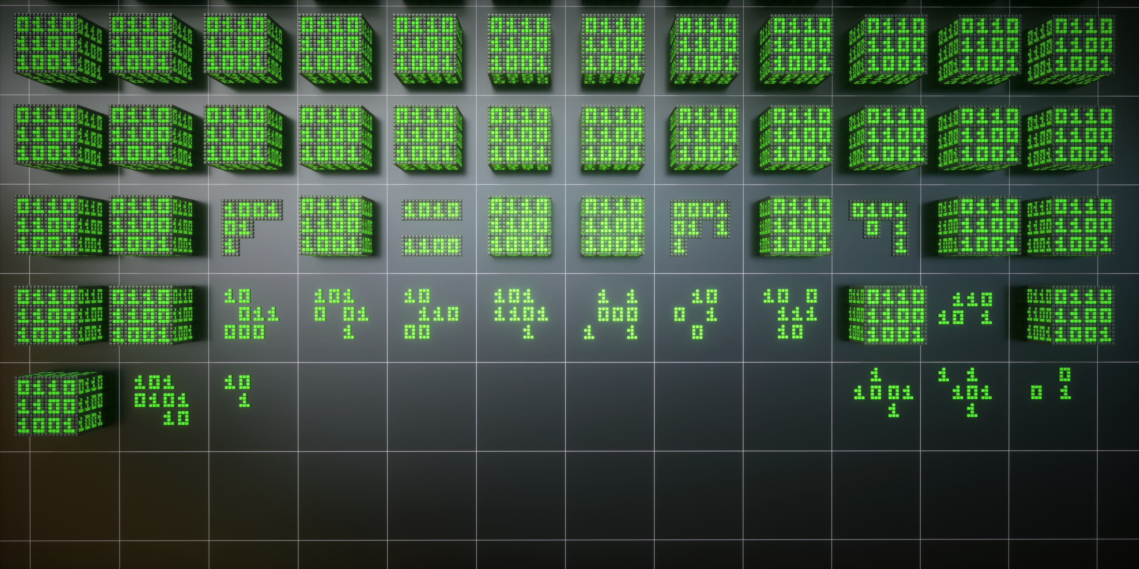
Chapter 1: Introduction
Why data mining?
data explosion, data rich but information poor
Data mining (knowledge discovery from data)
quality vs. efficiency, interesting patterns
different views: data, knowledge, method, application
data mining pipeline
Ravi Starzl, PhD - Data Mining Fall 2023
Notes:
Why Data Mining?
The motivation behind data mining stems from the current era's data explosion, where we are surrounded by vast amounts of data generated from numerous sources like the internet, social media, and digital platforms. Despite this abundance, there's a paradox of being data-rich but information-poor. This scenario highlights the crucial need for data mining, which aims to bridge the gap between the sheer volume of data and the extraction of meaningful information.
Data Mining: Knowledge Discovery from Data
Data mining, often described as knowledge discovery from data (KDD), involves analyzing large datasets to unearth hidden patterns, correlations, and anomalies. The challenge lies in achieving a balance between the quality of the patterns discovered and the efficiency of the mining process. Quality entails finding relevant and significant patterns, while efficiency focuses on the speed and resource usage of the process.
Interesting Patterns
The core objective of data mining is to reveal interesting patterns that offer new insights or practical applications. These patterns need to be not only novel and potentially useful but also understandable to provide real value.
Different Views in Data Mining
Data mining encompasses various perspectives. The 'Data View' focuses on the type and quality of data being mined. It involves understanding data formats, cleaning, and preprocessing to ensure data integrity. The 'Knowledge View' is about the kind of insights and patterns that can be extracted from the data, which involves identifying trends, anomalies, or associations. The 'Method View' delves into the techniques and algorithms used in mining data, which can range from statistical methods to complex machine learning algorithms. Finally, the 'Application View' looks at how the results of data mining are applied in real-world scenarios, influencing decision-making in various fields such as healthcare, finance, marketing, and more.
Data Mining Pipeline
The data mining pipeline is an integral concept, representing the flow of data from its raw form to actionable insights. This pipeline encapsulates all stages from data collection and preprocessing to analysis, pattern discovery, and the eventual application of the findings. This streamlined process is critical for transforming vast, unstructured data into meaningful information that can drive decision-making and innovation.

Slide 8

Chapter 2: Getting to Know Your Data
Data objects and attribute types
nominal, binary, ordinal, numeric
interval-scaled, ratio-scaled, discrete vs. continuous
Measuring data similarity and dissimilarity
data matrix vs. dissimilarity matrix
Descriptive summarization: centrality, dispersion
Ravi Starzl, PhD - Data Mining Fall 2023
Notes:
Data Objects and Attribute Types
Understanding your data begins with familiarizing yourself with the different types of data objects and their attributes. Attributes can be categorized as nominal, binary, ordinal, or numeric. Nominal attributes represent categories without any intrinsic order (like colors or names). Binary attributes are a special case of nominal attributes with only two categories (0 or 1, true or false). Ordinal attributes, on the other hand, have a set order or ranking (like rankings in a competition), but the difference between ranks is not necessarily meaningful. Numeric attributes are quantifiable and are further divided into interval-scaled and ratio-scaled. Interval-scaled attributes have meaningful distances between values but no true zero point (like temperature in Celsius), while ratio-scaled attributes have both meaningful distances and a true zero point (like weight or height). Additionally, attributes can be discrete (countable, like the number of students) or continuous (measurable, like temperature or time).
Measuring Data Similarity and Dissimilarity
A key aspect of data analysis is assessing how similar or dissimilar data objects are. This is typically done using a data matrix, which represents data objects in rows and their attributes in columns. Conversely, a dissimilarity matrix focuses on the differences between pairs of objects, quantifying how unlike they are based on their attributes. Choosing the right measure for similarity or dissimilarity, like Euclidean distance for numeric data or matching for binary data, is crucial for accurate analysis.
Descriptive Summarization: Centrality and Dispersion
Descriptive summarization involves using statistical measures to understand the central tendency and variability of data. Measures of centrality, such as the mean, median, and mode, describe the central point of the data distribution. Dispersion measures, including variance, standard deviation, and range, describe how spread out the data is. These summaries provide a quick snapshot of the data's overall characteristics and are essential in the preliminary analysis phase to gain insights and guide further in-depth analysis.

Slide 9

Chapter 3: Data Preprocessing
Why preprocessing data?
Data cleaning
Data integration
Data reduction
Data transformation and discretization
Ravi Starzl, PhD - Data Mining Fall 2023
Notes:
Why Preprocess Data?
Data preprocessing is a critical step in the data mining process. It involves transforming raw data into a format that is more suitable for analysis. The need for preprocessing arises because real-world data is often incomplete, inconsistent, or lacking in certain behaviors or trends. Preprocessing enhances the quality of the data, ensuring that the final results are valid and applicable.
Data Cleaning
This step deals with identifying and correcting errors and inconsistencies in the data to improve its quality. This could involve filling in missing values, smoothing noisy data, identifying or removing outliers, and resolving inconsistencies. Data cleaning is crucial as it directly impacts the accuracy and reliability of the data mining process.
Data Integration
Data integration involves combining data from different sources, providing a unified view of these data. This step is essential when data is collected from various databases, each with its own method of storage and access. Challenges in data integration include dealing with data conflicts and redundancies.
Data Reduction
The goal of data reduction is to reduce the volume but produce the same or similar analytical results. Techniques in data reduction include dimensionality reduction, where redundant and irrelevant features are removed, and numerosity reduction, where data is replaced or estimated by alternative, smaller data representations such as parametric models or histograms.
Data Transformation and Discretization
Data transformation involves converting data into a format that can be easily and effectively processed for data mining. It can include normalization, where data attributes are scaled so as to fall within a small specified range, and aggregation, where summarization or aggregation operations are applied to the data. Discretization is another important aspect of transformation, involving the conversion of continuous data into discrete counterparts, often as part of data preparation for specific analysis techniques.

Slide 10

Chapter 4: Data Warehouse
Separate data store for information processing
Characteristics
subject-oriented, integrated, time-variant, nonvolatile
OLTP vs. OLAP
day to day operation vs. decision support
Ravi Starzl, PhD - Data Mining Fall 2023
Notes:
Separate Data Store for Information Processing
A data warehouse is a specialized type of data store designed specifically for information processing, analysis, and reporting. It is distinct from operational databases, as it focuses on the storage, retrieval, and management of large volumes of data that is typically used for analysis rather than day-to-day operations.
Characteristics of a Data Warehouse
Subject-Oriented: Data warehouses are organized around major subjects of the business, like customers, products, sales, etc., rather than being focused on ongoing operations.
Integrated: They integrate data from various sources into a coherent whole. This integration involves ensuring consistent naming conventions, measurements, encoding structures, etc.
Time-Variant: The data in a data warehouse is time-stamped and stored in a way to allow comparisons across different time periods. This characteristic is crucial for trend analysis and tracking historical changes.
Nonvolatile: Once entered into the warehouse, data is not updated or deleted. It provides a stable and consistent dataset for analysis and decision-making.
OLTP vs. OLAP
OLTP (Online Transaction Processing): This is related to the handling of day-to-day operations. OLTP systems are optimized for managing transaction-oriented applications such as retail sales, banking, and order processing. They are designed for efficiency in managing transactions, characterized by a large number of short online transactions.
OLAP (Online Analytical Processing): OLAP, on the other hand, is geared towards decision support functions. It is designed for query and analysis rather than for transaction processing. OLAP systems are optimized for complex queries and are used to analyze historical data and identify trends, patterns, and relationships.
The distinction between OLTP and OLAP highlights the different focuses of data systems, with OLTP handling the routine transaction data and OLAP providing the framework for deeper data analysis and strategic decision-making. The data warehouse environment typically utilizes OLAP tools for extracting and viewing data from multiple perspectives, which is a key component of strategic planning and business analysis.

Slide 11

Chapter 4 & 5: Data Cube
Multi-dimensional data model
Dimensions, facts
Schema: star, snowflake, fact constellation
Typical operations
roll-up, drill-down, slice and dice, pivot, drillacross, drill-through
Cuboid cells, materialization of data cube
full, partial, or no materialization
Ravi Starzl, PhD - Data Mining Fall 2023
Notes:
Multi-Dimensional Data Model
The data cube represents a multi-dimensional model used in data warehousing, allowing for complex data analysis and reporting. This model enables the viewing of data across various dimensions, making it easier to understand patterns and relationships.
Dimensions and Facts
In a data cube, 'dimensions' are the different aspects or categories of the data, like time, geography, or product categories. 'Facts' are the measurable quantities or metrics that are of interest, such as sales figures or quantities.
Schema Types: Star, Snowflake, Fact Constellation
The organization of a data cube can follow different schemas. The star schema is the simplest, with a central fact table connected to multiple dimension tables. The snowflake schema is a more normalized version of the star schema, with dimension tables connected to other dimension tables. The fact constellation schema is a more complex structure that supports multiple fact tables sharing dimension tables.
Data Cube Operations
Operations on data cubes include roll-up (increasing the level of aggregation), drill-down (breaking data into more detail), slice (extracting a subset of data based on one dimension), dice (extracting a subset based on multiple dimensions), pivot (reorienting the cube's dimensions), and drill-across or drill-through (extending the analysis across different cubes or to detailed data outside the cube).
Cuboid Cells and Materialization
A data cube is made up of cuboid cells, each representing a unique combination of dimension members. Materialization refers to how these cuboids are stored. Full materialization stores all possible cuboids, partial materialization stores a select few, and no materialization computes them on-the-fly as needed. The choice between these approaches depends on storage constraints and performance requirements.

Slide 12

Chap 6 & 7: Frequent Pattern Mining
Basic concepts, roadmap
Mining frequent itemsets
Mining association rules
Correlation analysis
Constraint-based association mining
Ravi Starzl, PhD - Data Mining Fall 2023
Notes:
Basic Concepts and Roadmap
Frequent pattern mining is a key aspect of data mining that focuses on identifying patterns, such as sets of items, subsequences, or structures that appear frequently in a dataset. The primary goal is to discover inherent regularities in data, like items that often occur together in transaction databases. The process involves two main steps: first, identifying the frequent itemsets, and then, using these itemsets to generate association rules.
Mining Frequent Itemsets
This stage is about finding sets of items that appear together in a dataset more often than a user-specified threshold. For example, in a retail context, it could involve finding which items are commonly purchased together. Various algorithms are used for this purpose, with the Apriori algorithm being one of the most well-known. These algorithms efficiently sift through large datasets to find itemsets that meet the frequency criteria.
Mining Association Rules
Once frequent itemsets are identified, the next step is to generate association rules, which help in understanding the relationships between different items in the dataset. An association rule is typically in the form of "if-then" statements. For instance, an association rule might state that if a customer buys bread and butter, they are likely to buy milk as well. Key measures in association rule mining are support (how often a rule is applicable to a given dataset) and confidence (how frequently items in the rule are purchased together).
Correlation Analysis
Correlation analysis goes beyond simple association by measuring the strength and direction of relationships between itemsets. It seeks to identify whether the presence of one item influences the presence of another, thereby uncovering more complex relationships in the data.
Constraint-Based Association Mining
This approach integrates user-specified constraints into the mining process to focus on more relevant patterns. Constraints can be on the size of the itemsets, the properties of the items, or the kind of patterns to be mined. This method helps in reducing the search space and improves the efficiency of the mining process by focusing on the most pertinent and useful patterns.

Slide 13

Chap 8: Classification
Basic concepts
Decision tree induction
Bayesian classification
Rule-based classification
Model evaluation and selection
Improve classification accuracy
Summary
Ravi Starzl, PhD - Data Mining Fall 2023
Notes:
Basic Concepts
Classification in data mining is a supervised learning technique that involves identifying the category or class of new observations based on a training set containing observations whose category membership is known. It's used in various applications like spam detection, credit scoring, and disease diagnosis.
Decision Tree Induction
This method involves building a decision tree model based on the input attributes. Each node in the tree represents a test on an attribute, each branch represents an outcome of the test, and leaf nodes represent classes or class distributions. Decision tree induction is popular due to its ease of interpretation and implementation.
Bayesian Classification
Bayesian classification is based on Bayes' Theorem. It calculates the probability of each class based on the attributes of the instances and selects the class with the highest probability. This method is particularly effective when the dimensionality of the input is high, as in text classification.
Rule-Based Classification
This approach involves constructing a set of if-then rules for classification. Rule-based classifiers are transparent and easy to understand. They work by applying these rules to new instances to determine their class.
Model Evaluation and Selection
Evaluating and selecting the right model is crucial in classification. Common methods for evaluation include using metrics like accuracy, precision, recall, and the F1 score. Techniques like cross-validation are often employed to ensure that the model generalizes well to unseen data.
Improving Classification Accuracy
Various techniques can be used to improve classification accuracy, including data preprocessing, feature selection, and using ensemble methods like bagging and boosting, which combine the predictions of multiple models to improve accuracy.

Slide 14

Chap 9: Advanced Classification
Bayesian belief networks
Backpropagation
Support vector machines
Lazy learning
Other classification methods
Additional topics regarding classification
Summary
Ravi Starzl, PhD - Data Mining Fall 2023
Notes:
Bayesian Belief Networks
Bayesian Belief Networks, also known as Bayesian Networks, are graphical models that represent the probabilistic relationships among a set of variables. They extend the basic ideas of Bayesian classification by using a directed acyclic graph to model dependencies among variables. This approach is particularly useful for dealing with complex classification problems where variables have interdependencies.
Backpropagation
Backpropagation is a key method in training artificial neural networks, especially in deep learning models. It involves a training algorithm that adjusts the weights of the neural network by propagating the error backward from the output layer to the input layer. This method is powerful for handling nonlinear data and can be used for both classification and regression tasks.
Support Vector Machines (SVM)
Support Vector Machines are a set of supervised learning methods used for classification and regression. In classification tasks, SVMs are particularly effective in high-dimensional spaces and for cases where the number of dimensions exceeds the number of samples. They work by finding the hyperplane that best separates the classes in the feature space.
Lazy Learning
Contrary to eager learning models that build a classification model before receiving test data, lazy learning methods, like k-Nearest Neighbors (k-NN), store the training data and wait until classification is requested before generalizing beyond the training data. This approach can be advantageous in scenarios where the data is constantly changing, as it avoids the need to rebuild the model each time.
Other Classification Methods
There are numerous other classification techniques, each with its own strengths and weaknesses. These include decision forests, gradient boosting machines, and nearest neighbor classifiers. The choice of method often depends on the nature of the data and the specific requirements of the task at hand.
Additional Topics Regarding Classification
Advanced classification also explores topics like handling imbalanced datasets, dealing with missing or noisy data, and scaling classification algorithms for large datasets. Techniques for feature selection and extraction also play a crucial role in enhancing model performance.

Slide 15

Chapter 10: Cluster Analysis
Basic concepts
Partitioning methods
Hierarchical methods
Density-based methods
Grid-based methods
Evaluation of clustering
Summary
Ravi Starzl, PhD - Data Mining Fall 2023
Notes:
Basic Concepts
Cluster analysis, or clustering, involves grouping a set of objects in such a way that objects in the same group (cluster) are more similar to each other than to those in other groups. It's a form of unsupervised learning used in statistical data analysis to identify patterns or groupings without reference to known structures.
Partitioning Methods
Partitioning methods, such as the K-Means algorithm, divide the dataset into a set of clusters. These methods start with an initial partition and then iteratively relocate objects between clusters to improve the partitioning based on a given criterion, such as minimizing the sum of distances within each cluster.
Hierarchical Methods
Hierarchical clustering builds a hierarchy of clusters either through a series of successive mergers (agglomerative approach) or by splitting clusters in a top-down fashion (divisive approach). The result is often presented as a dendrogram, which shows the arrangement of the clusters produced at each level of the hierarchy.
Density-Based Methods
These methods, like DBSCAN (Density-Based Spatial Clustering of Applications with Noise), identify clusters as areas of higher density within the data space compared to the regions of lower density. They are particularly good at identifying clusters of arbitrary shapes and sizes and can handle noise in the data.
Grid-Based Methods
Grid-based methods, such as STING (Statistical Information Grid), divide the space into a finite number of cells that form a grid structure and then perform clustering operations on the grid structure. These methods are typically very fast as they quantize the space into a finite number of cells and then do the processing on a per-cell basis.
Evaluation of Clustering
Evaluating the quality of clustering is crucial, but can be challenging as there's often no "ground truth" to compare against. Internal measures, like cohesion and separation, assess the clusters based on the distances between objects in a cluster and across clusters. External measures compare the clustering results to a pre-defined structure or ground truth, if available.

Slide 16

Chapter 11: Advanced Cluster Analysis
Probabilistic model-based clustering
Clustering high-dimensional data
Clustering graph and network data
Clustering with constraints
Ravi Starzl, PhD - Data Mining Fall 2023
Notes:
Probabilistic Model-Based Clustering
Probabilistic model-based clustering approaches use statistical models to represent the data generation process for each cluster. These methods, such as Gaussian Mixture Models, assume that the data points are generated from a mixture of several probability distributions, each corresponding to a different cluster. The goal is to estimate the parameters of these distributions to maximize the likelihood of the observed data. This approach is powerful in capturing the uncertainty associated with assigning points to clusters and can effectively handle overlapping clusters.
Clustering High-Dimensional Data
Clustering in high-dimensional spaces poses unique challenges, primarily due to the curse of dimensionality, where the distance between pairs of points becomes less meaningful as the number of dimensions increases. Techniques like subspace clustering and projection methods are used to identify clusters in subspaces of the original high-dimensional space. Dimensionality reduction techniques such as PCA (Principal Component Analysis) are also commonly employed to reduce the number of dimensions while preserving the structure of the data.
Clustering Graph and Network Data
This involves the clustering of data that is represented in the form of graphs or networks. Techniques like spectral clustering use the eigenvalues of matrices associated with the graph to identify clusters. These methods are particularly useful in domains like social network analysis, bioinformatics, and communication networks, where data is inherently graph-structured.
Clustering with Constraints
In many real-world applications, there are constraints that need to be considered during the clustering process. Constraint-based clustering incorporates background knowledge or specific requirements into the clustering process. These constraints can be instance-level, specifying that certain pairs of points should or should not be in the same cluster, or cluster-level, dictating properties that the clusters should have. Integrating these constraints can lead to more meaningful and practical clustering results.

Slide 17

Chapter 12: Outlier Analysis
Outlier & outlier analysis
Statistical approaches
Proximity-based approaches
Clustering-based approaches
Classification-based approaches
Mining contextual and collective outliers
Outlier detection in high dimensional data
Notes:
Outlier & Outlier Analysis
An outlier is a data point that deviates significantly from the rest of the data. It can indicate a measurement error, a novelty, or a data point that requires further investigation. Outlier analysis is crucial in many fields such as fraud detection, network security, and fault diagnosis, as it helps in identifying unusual patterns that could be indicative of significant, often critical, events.
Statistical Approaches
Statistical methods for outlier detection involve modeling the underlying distribution of the data and then finding instances that deviate significantly from this model. Common techniques include using standard deviations, box plots, or more complex distribution models. These methods assume that the majority of the data points are generated by a certain statistical distribution, and points that lie in the tails of the distribution are flagged as outliers.
Proximity-Based Approaches
These methods identify outliers by considering the distance or similarity of a data point to its neighbors. Points that are far away from their neighbors are considered outliers. Techniques like k-nearest neighbors (k-NN) fall into this category. Proximity-based methods are particularly useful in datasets where normal data points form dense clusters.
Clustering-Based Approaches
In clustering-based outlier detection, data points that do not belong to any cluster or are far from their nearest clusters are considered outliers. This approach is effective in scenarios where normal data forms distinct groups.
Classification-Based Approaches
These approaches use classification algorithms to identify outliers. The data is first labeled as 'normal' and 'outlier,' and then a classification model is trained on this labeled data. New data points are then classified as either normal or outliers based on this model.
Mining Contextual and Collective Outliers
Contextual outliers are data points that are anomalous in a specific context but not otherwise. Collective outliers are collections of data points that are anomalous in relation to the entire dataset. Detecting these types of outliers involves understanding the context or the relationship between data points.
Outlier Detection in High Dimensional Data
Detecting outliers in high-dimensional spaces is challenging due to the curse of dimensionality. Techniques like dimensionality reduction or feature selection are often used to simplify the data before applying outlier detection methods. Alternatively, methods specifically designed for high-dimensional data, such as subspace outlier detection, are employed.

Slide 18

Chap 13: Data Mining Trends & Research Frontiers
Mining complex data types
Other methodologies of data mining
Data mining applications
Data mining and society
Data mining trends

Slide 19
Thank you for a busy yet enjoyable semester!
Look forward to seeing your final project reports!
Data mining in the real world!

